Slide 1

Student:
Mamoun Faisel Alkorom
Course name :
Full Stack Web Development “PHP” .
2022/2023

Slide 2
Outline
1. Introduction
2. Problem Statement
3. General definition of “POS”
4. Design Models
5. Result .

Slide 3
1. Introduction
Because programming is a way to help us to develop the quality of life for the world, So we have created a web site that includes a POS system to provide the necessary needs .

Slide 4
2. Problem Statement
Due to the old way of the manual system
We provide some solutions :
reduce the error rate
avoid problems in counting
easier calculations
quantities available

Slide 5
3. General definition of “POS”
Point Of Sale web site system, Can be used at restaurants, hospitals, gas stations , hotels , Market etc. It's provides so many pages to help you make a complete purchase process with an invoice including prices and total, Equipped with an informative dashboard .

Slide 6
What you can do via this website !
Transactions
Create Items
Create
Users
List of items names and prices and quantities with total price.
Including the price , cost
and stock management.
Users management page.

Slide 7
4. Design Model a. Technology :
1
4
HTMl
BootStrap
2
5
CSS
PHP
3
6
JavaScript
MYSQL

Slide 8
b.Tools
1
2
3
4
Git
Postman
VScode
XAMPP

Slide 9
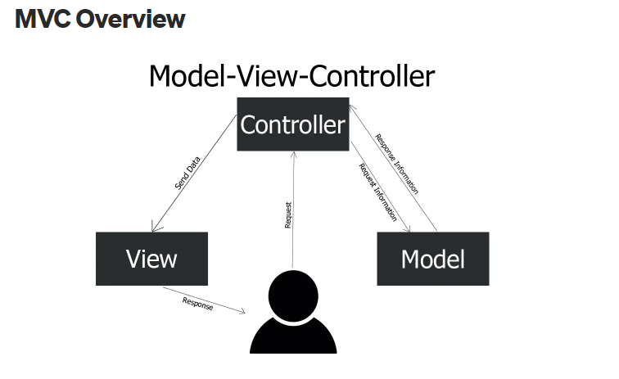
c. MVC Design

Slide 10
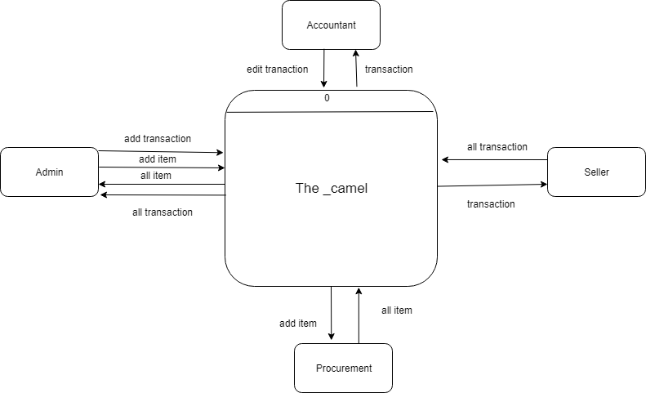
Context Diagram

Slide 11
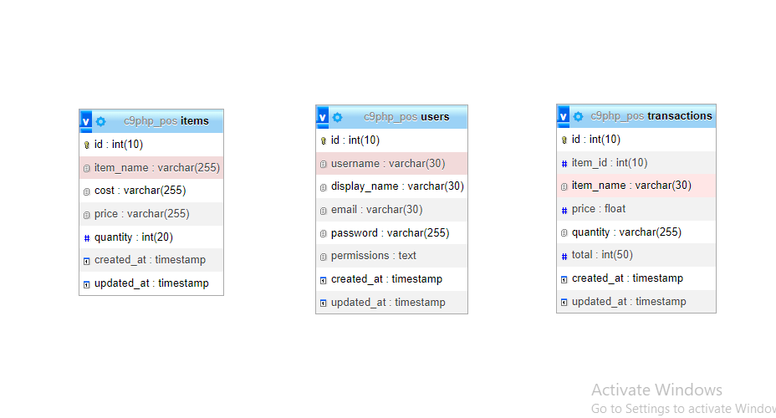
MySQL DataBase

Slide 12
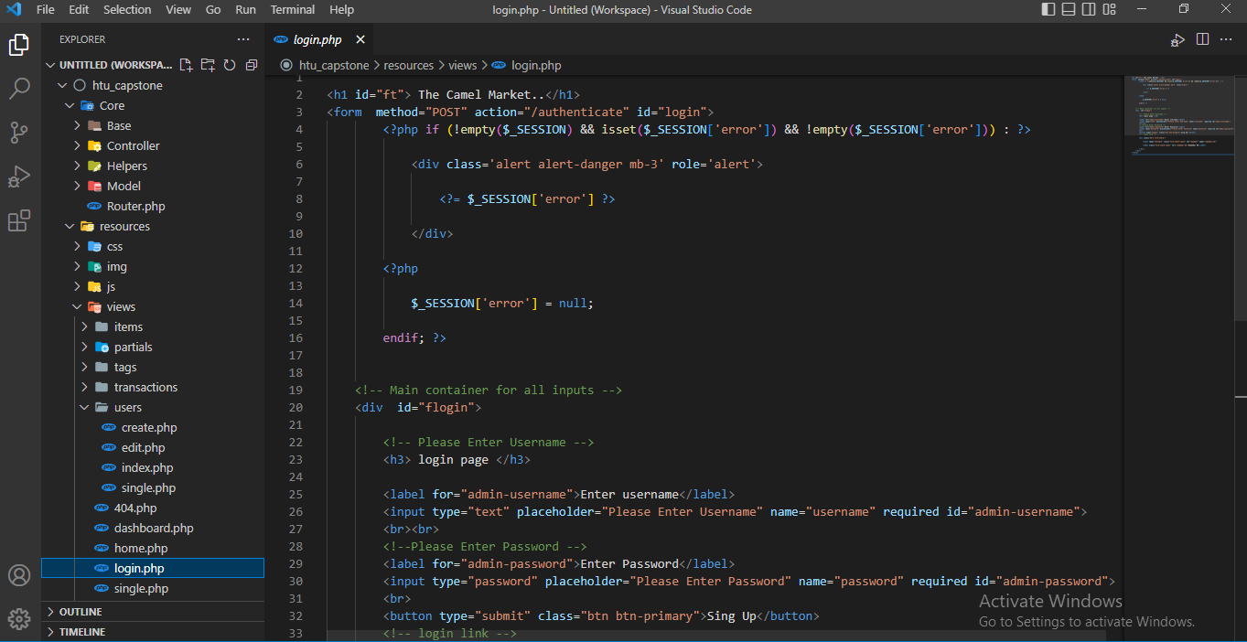
Overview of code

Slide 13
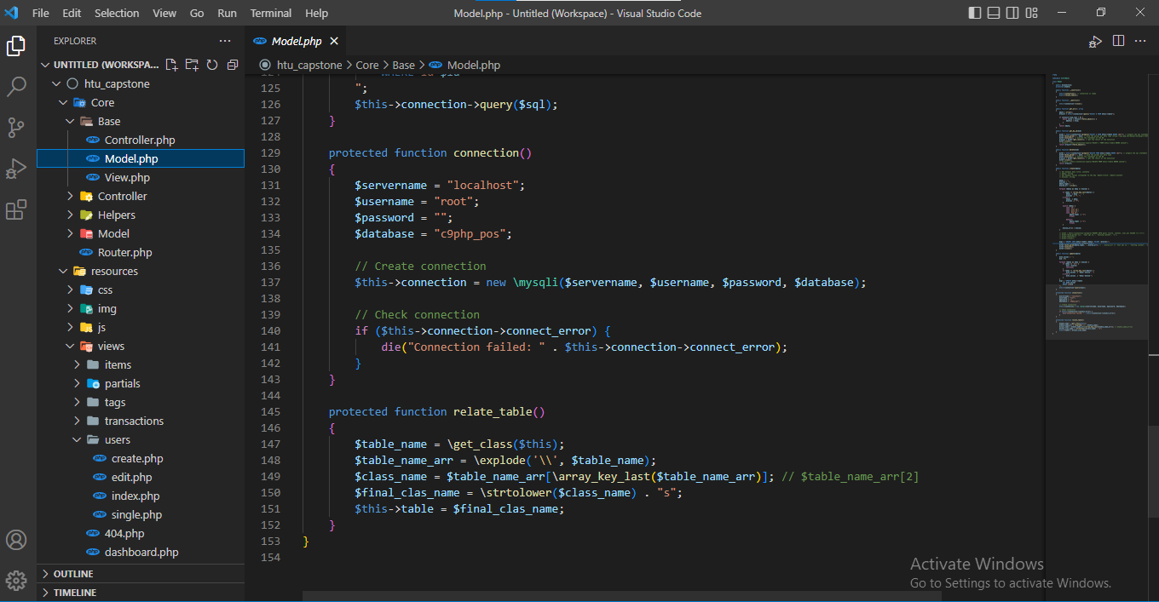
Overview of code

Slide 14
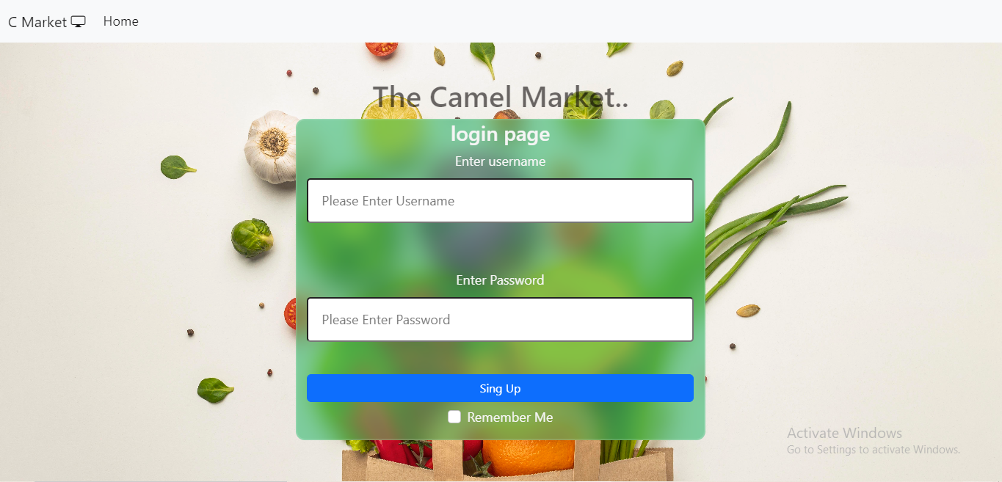
5. Result

Slide 15
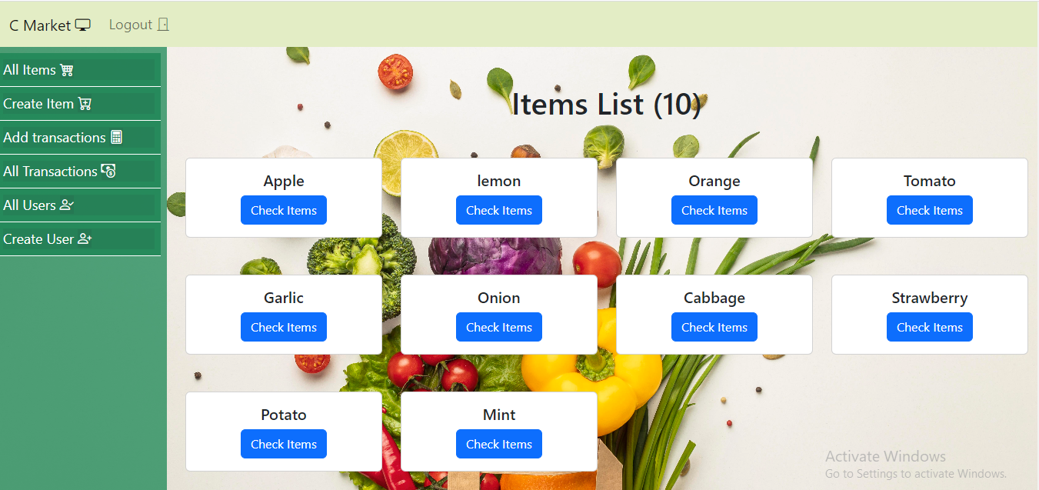
Overview of the application

Slide 16
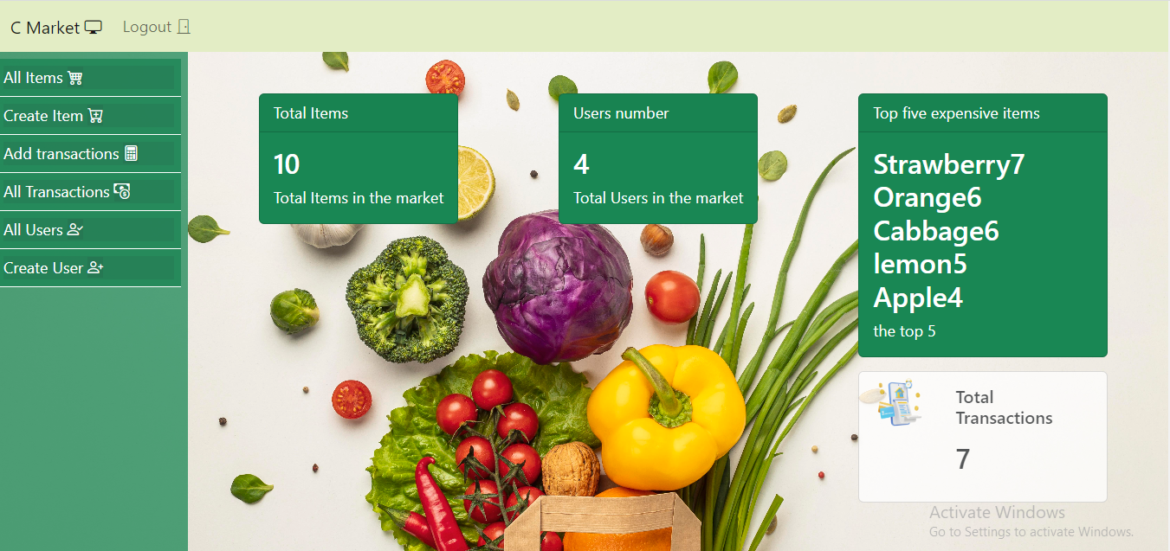
Overview of the application

Slide 17
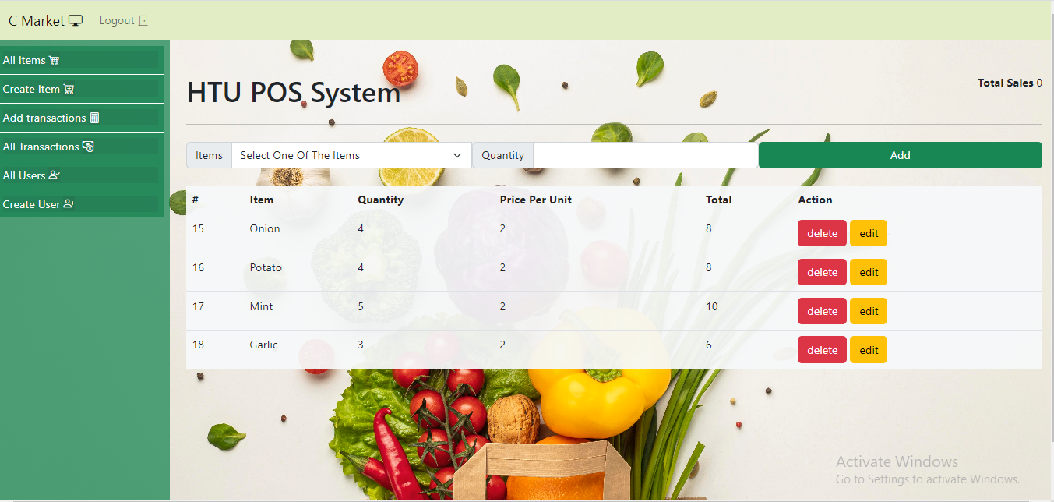
Overview of the application

Slide 18

Thank you for your time and attention

